Slide 1
OmicsNet and OmicsNetR Web server project
Mateusz Wiktorzak
11.05.2023

Slide 2
What are omics?
They relate to disciplines with „-omics” suffix, such as genomics, proteomics, metabolomics, metagenomics, phenomics, transcriptomics – studies about molecules living within living organisms.

Slide 3
Introduction
Notes:
What will be mentioned: OmicsNetR, OmicsNet

Slide 4
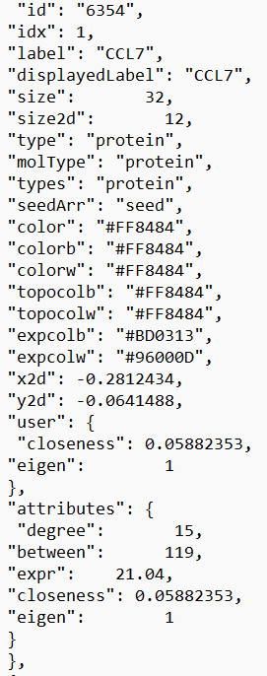
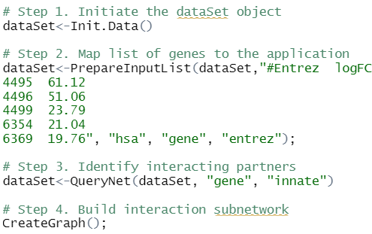
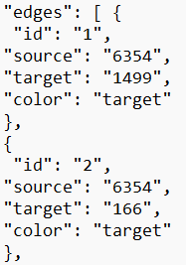
OmicsNetR

Slide 5
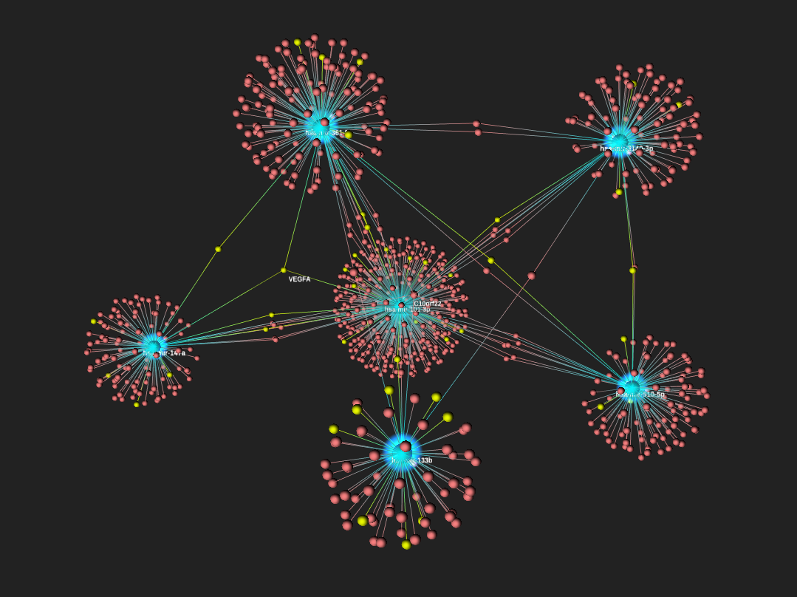
OmicsNet
Notes:
Easy-to-use, web-based platform that allows researchers to easily create and visualize biological networks in 3D space. It accepts one or more lists of biological features (genes, proteins, metabolites, etc.) and then searches for their direct interacting partners from various molecular interaction databases.

Slide 6
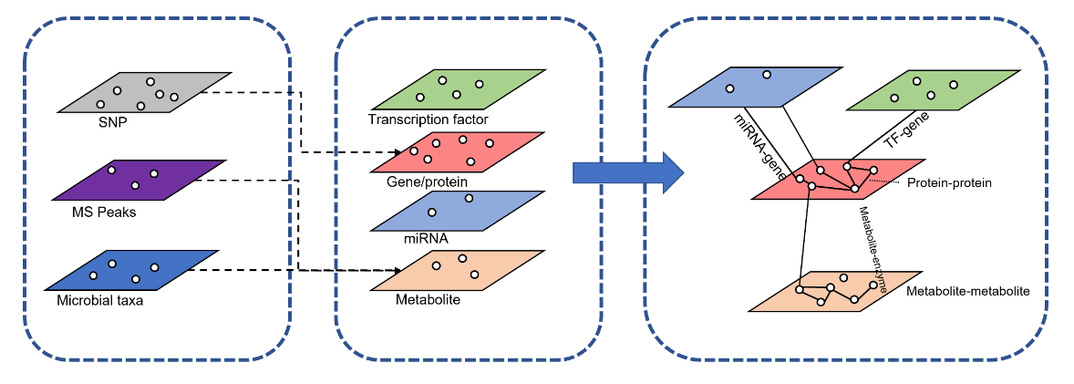
How OmicsNet work?
Goal:
Link untargeted MS peaks, SNPs and microbial taxa to knowledge framework
SNP – single nuclear polymorphism
MS peaks – mass spectrum peaks, they concern heaviness of ions
Microbial taxa – specifies how microorganisms can be grouped together
Notes:
SNPs from genetic variation studies, LC-MS peaks from untargeted metabolomics, and taxonomic signatures from microbiome studies. Connecting these data types with conventional molecular interaction networks require extra annotation steps to link SNPs to genes, peaks to metabolites, or microbial activities to their capacities of metabolite production.

Slide 7
Mentioned biological molecules
Gene: A segment of DNA, encodes a protein or RNA molecule.
Protein: Complex molecule.
Transcription factor: A regulatory protein that binds to DNA sequences and controls the process of transcription.
miRNA (microRNA): Play a significant role in gene expression regulation.
Metabolite: Products of metabolic processes in organisms.

Slide 8
SNP
SNPs (Single Nucleotide Polymorphisms) are common genetic variations that occur within a population.
In a SNP, the variation occurs when a single nucleotide (A, T, C, or G) is replaced by another nucleotide.
They can have different effects on gene function and can be associated with various traits, diseases, and drug responses.
Over the past two decades extensive collections of SNPs were made.
SNPs make it possible to perform SNP-gene mapping.

Slide 9
LC-MS peaks
LC-MS peaks refer to peaks obtained in liquid chromatography-mass spectrometry analysis.
By analyzing LC-MS peaks in OmicsNet, one can obtain information about the chemical composition of samples, identify potential biomarkers, and discover biological dependencies between chemical compounds. This tool contributes to a better understanding of complex omics data and their biological significance.

Slide 10
Microbial taxonomics
Microbial taxa can contribute to network construction by representing identified microorganisms as nodes and their relationships or associations as edges.
It can be used for the analysis and interpretation of omics data.
Taxonomic data can be used to analyze differences in the composition of the microbiome between groups of healthy and diseased patients. It can also be used to identify microbial biomarkers, which are microorganisms or groups of microorganisms associated with specific health states or diseases.

Slide 11
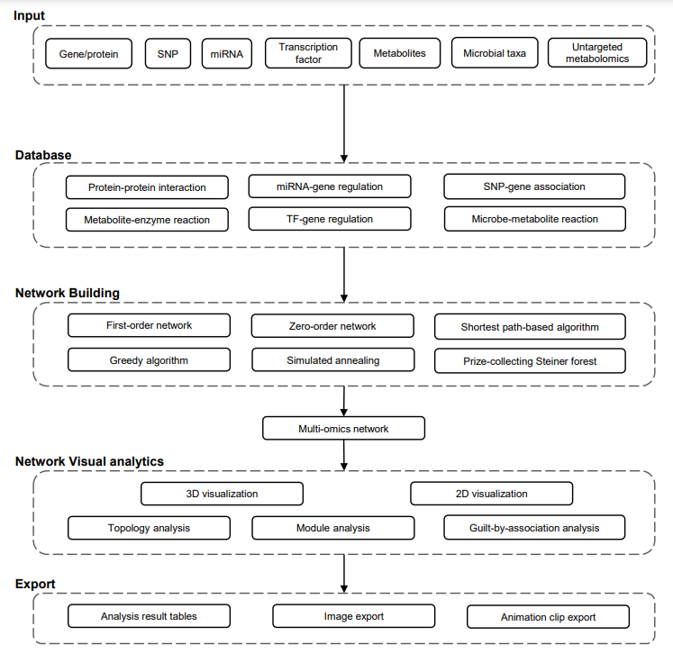
Notes:
The workflow of OmicsNet can be summarized into four steps - data upload, database selection, network creation and network visual analytics. Users can upload lists of genes, proteins, transcription factors, miRNAs, metabolites, LC-MS peaks, microbial taxa, or SNPs to search different molecular interaction databases or perform annotation. The results will be merged to create multi-omics networks which can be optionally customization using various methods. The subnetworks can be explored in 2D or 3D space with comprehensive built-in support for layouts, network analysis and functional analysis. The numbers in the round brackets indicate the number of options available for each category.

Slide 12
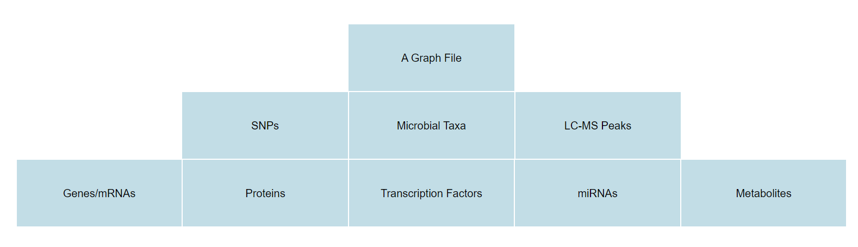
Input

Slide 13
Key Features of OmicsNet
Interactive 2D/3D network visualization in web browser.
Enable integration of multiple types of molecular interactions.
Built-in knowledgebase for network building:
- Protein-protein interaction - Transcription factor-gene regulation - miRNA-gene regulation - Metabolite-protein interaction
Support integration of less well-established omics data types by using computational predictions:
- SNPs - Microbial taxa - Untargeted metabolomics MS peaks

Slide 14
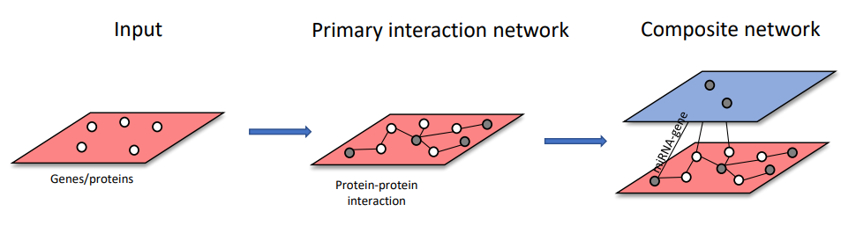
Single list network bulding
Primary interaction network – seeds and immediate interacting partners
Secondary interactions are searched in molecules contained in the primary network

Slide 15
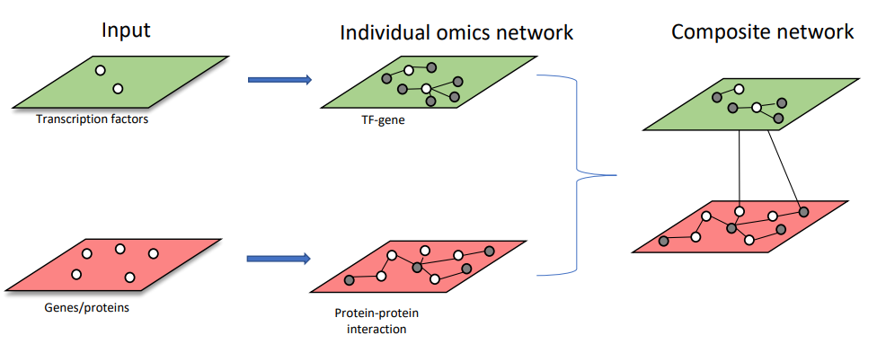
Multiple list network building
Notes:
Single list networks are build and then the are merged together through shared nodes

Slide 16
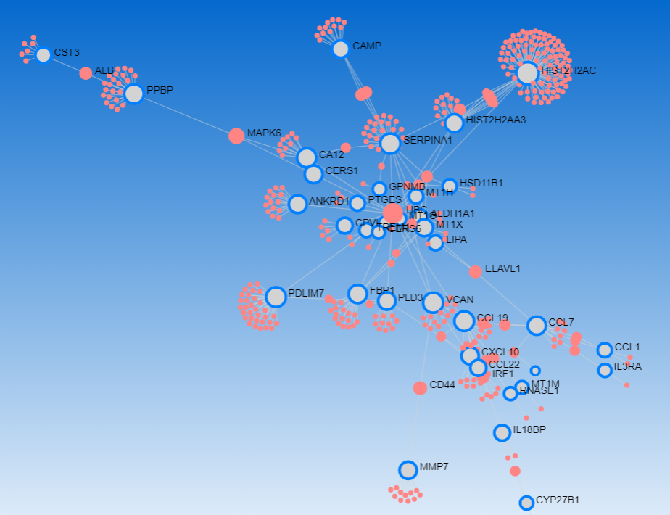
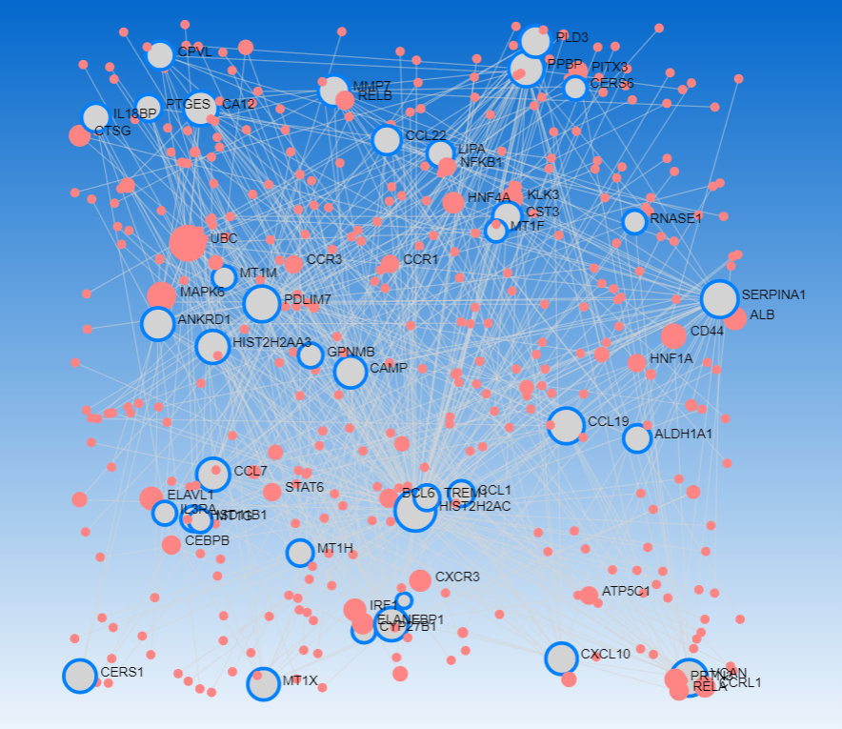
Auto Layout
Random Layout

Slide 17
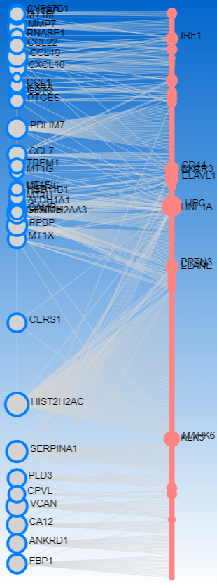
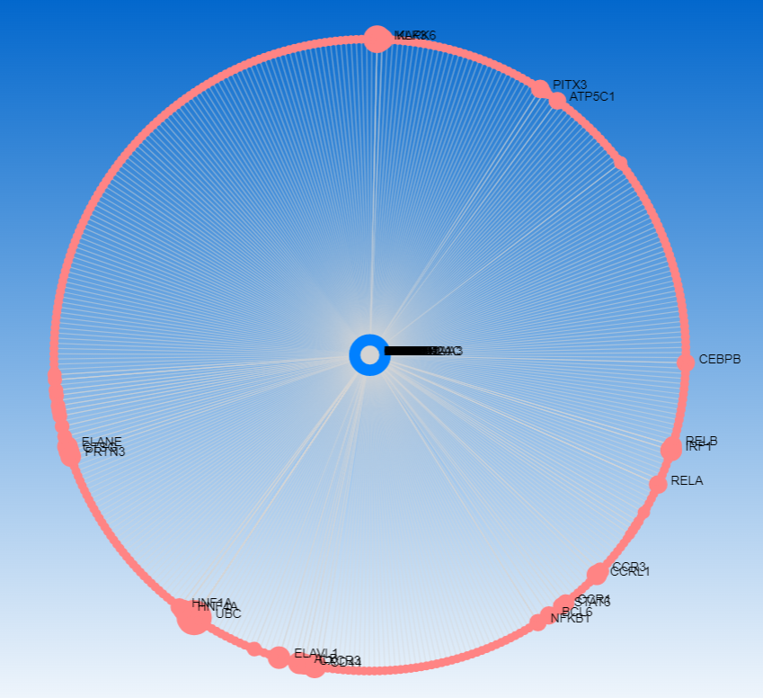
Linear Bipartite
Circular Bipartite

Slide 18
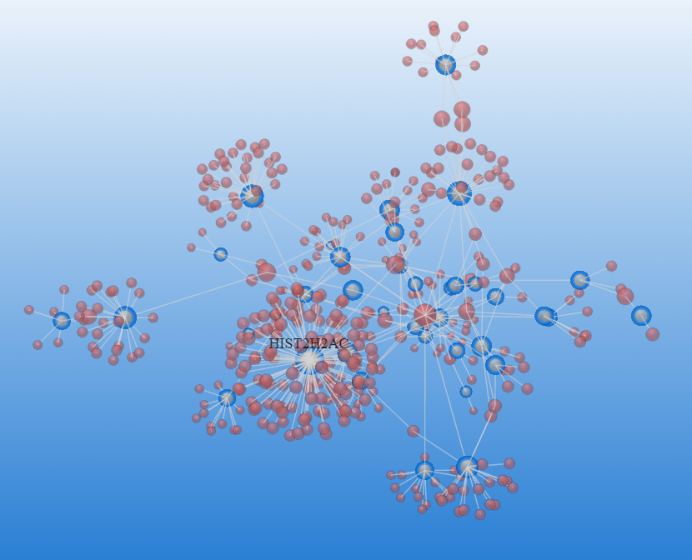
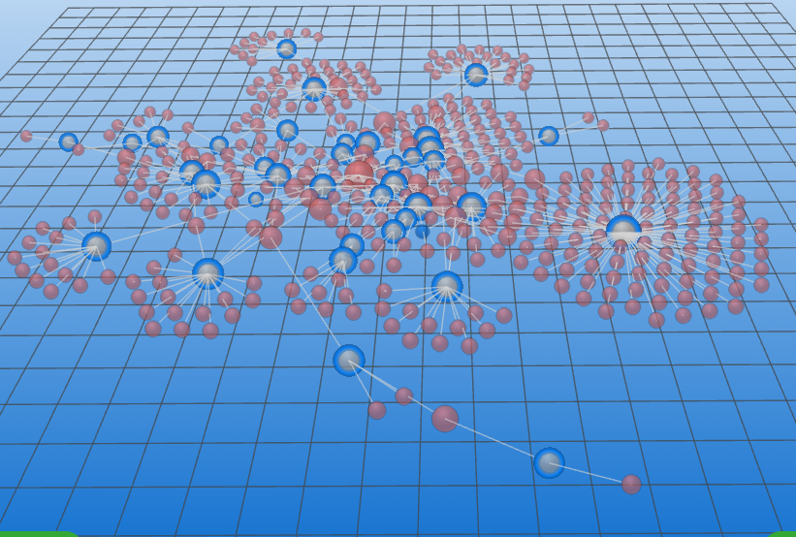
Standard
Perspective

Slide 19
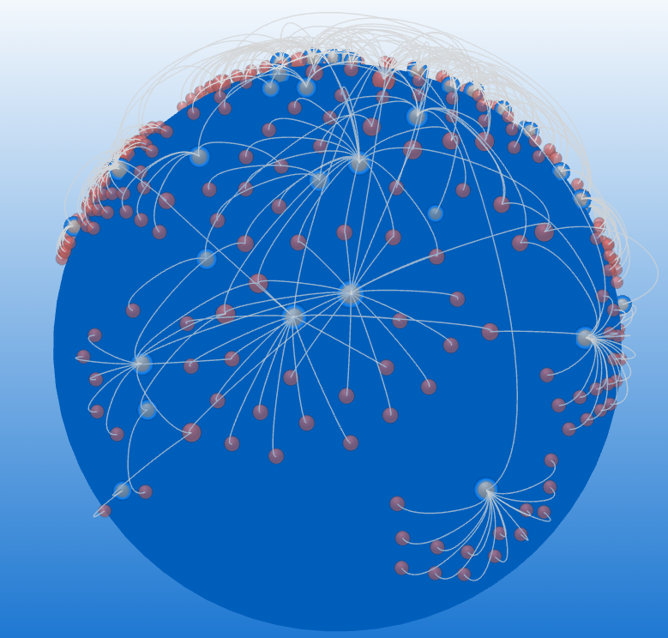
Spherical

Slide 20
Analysis in OmicsNet

Slide 21
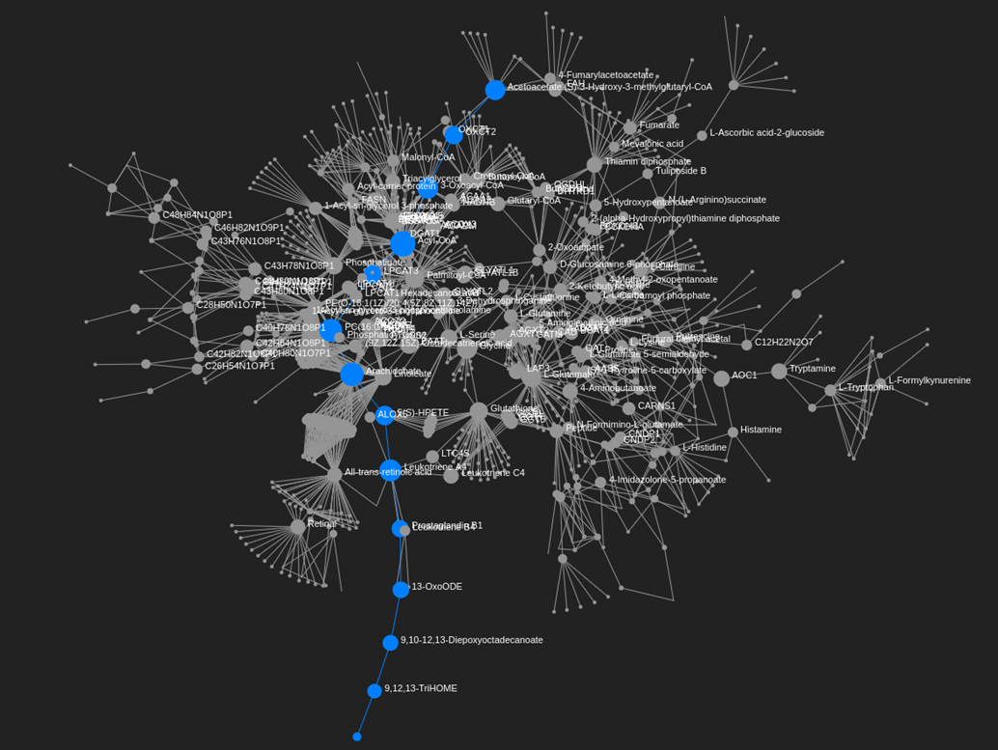
Shortest path highlighted in a MS peak-based multi-omics network

Slide 22
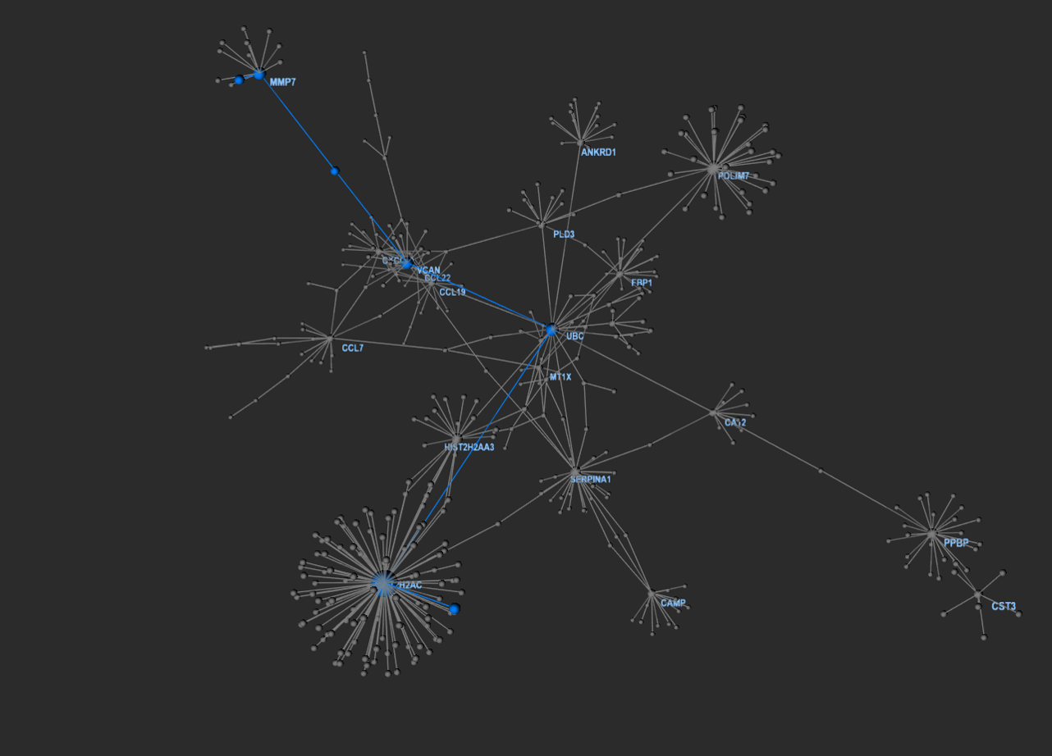
PPI network showing the shortest path between two nodes

Slide 23
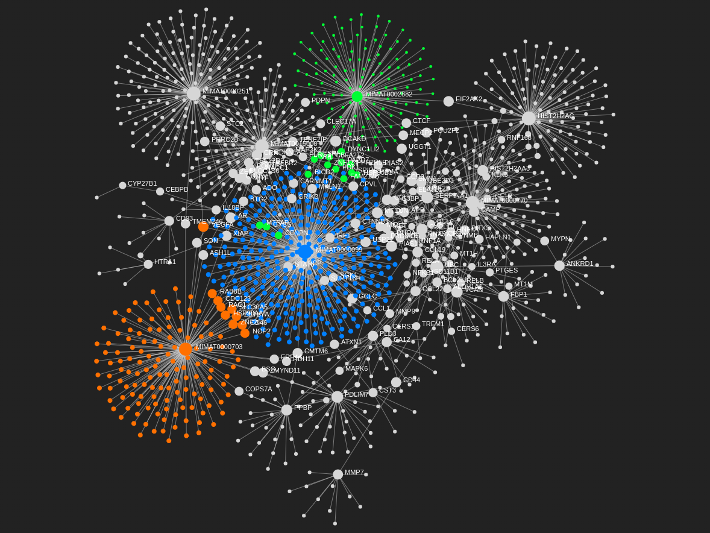
mRNA-miRNA network with top three modules highlighted

Slide 24
Visualizations in OmicsNet

Slide 25
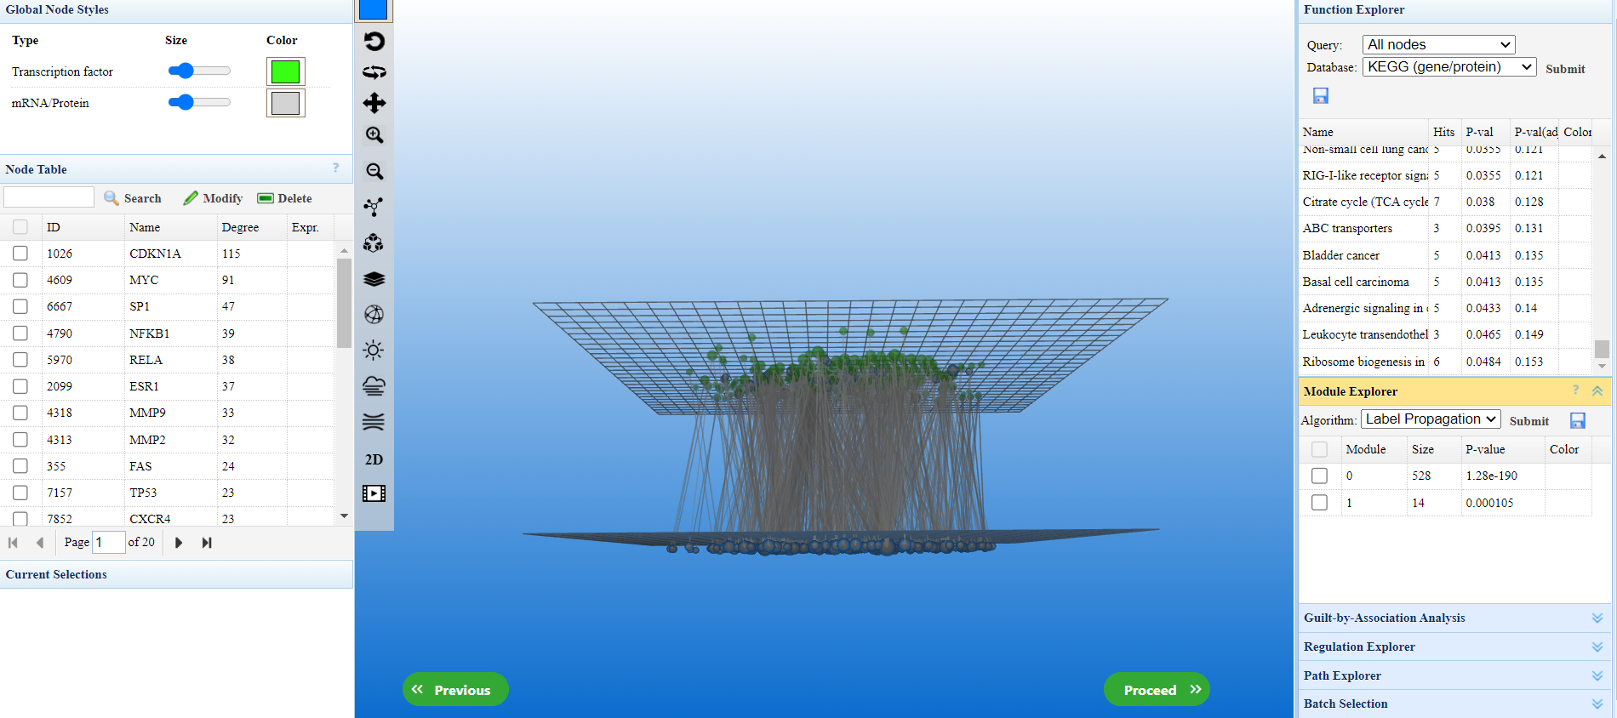
Transcription factor and mRNA/Protein Composite network
Notes:
Transcription factors are proteins involved in the process of converting, or transcribing, DNA into RNA

Slide 26
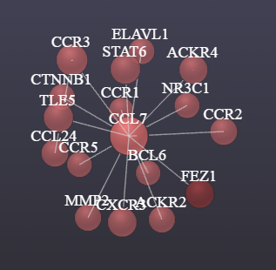
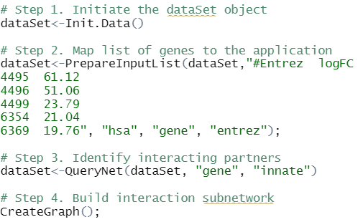
List of genes

Slide 27
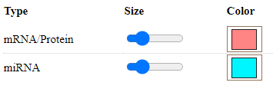
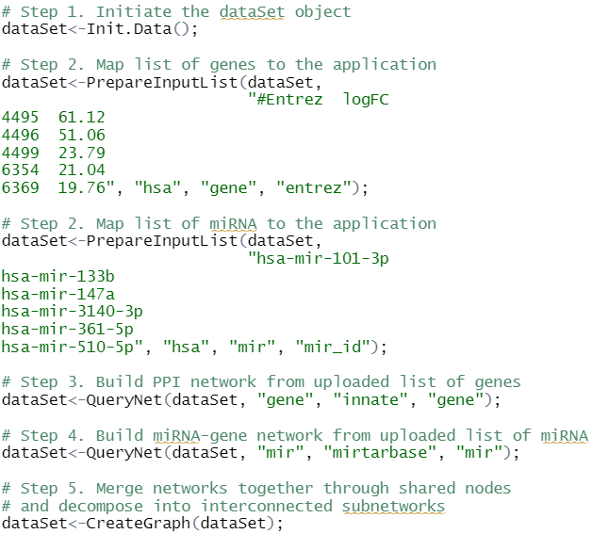
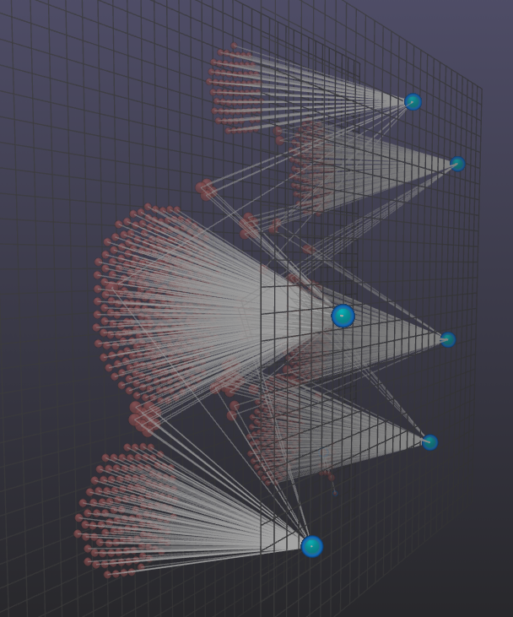
Integration of genes and miRNA

Slide 28
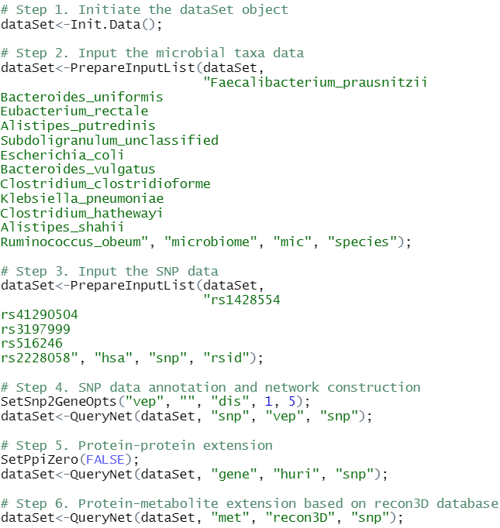
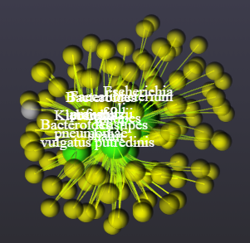
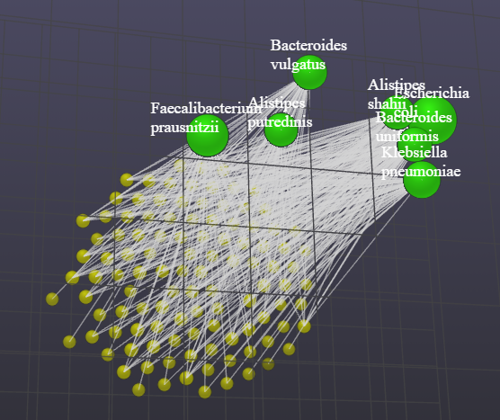
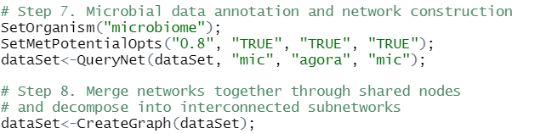
Integration of SNPs and Microbial Taxa

Slide 29
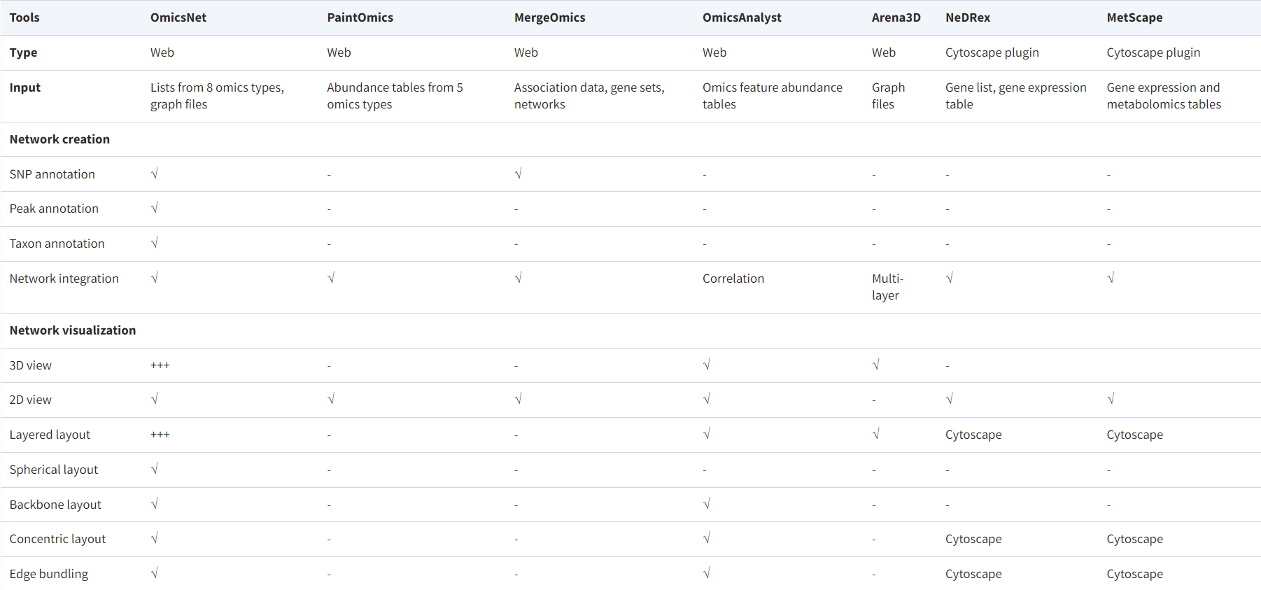
Comparison with other tools

Slide 30
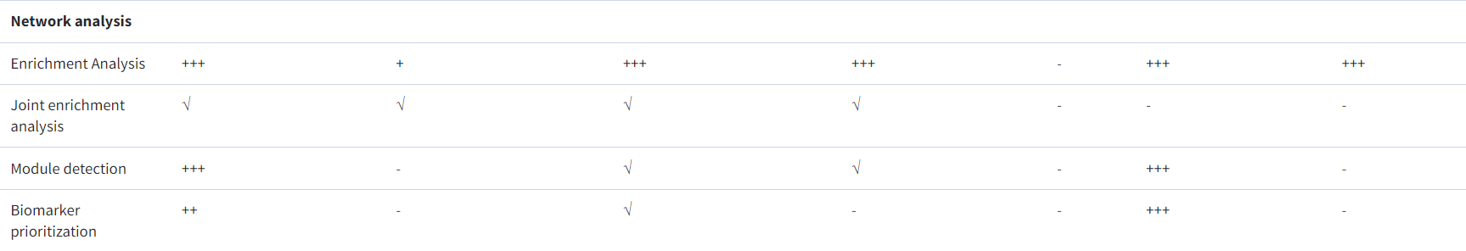

Slide 31
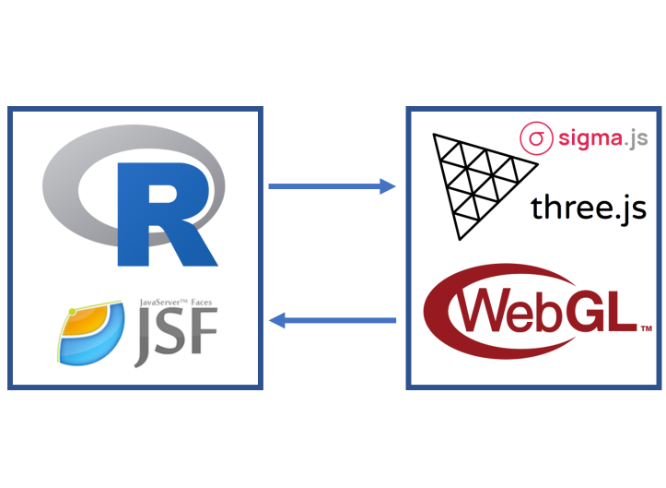
Implementation
Client-server framework that uses Java and R server for network construction and some analysis functions.
Browser-based application using WebGL interfaced by Three.js to visualize 3D network interactively.
Sigma.js, a canvas-based graphing library is used for 2D network visualization

Slide 32
3D visualization technologies
WebGL:
- JavaScript API allowing the rendering of 3D graphics in web browser without plug-ins
- High performance, GPU accelerated
Three.js
- Framework interfacing with WebGL to display 3D graphics
- Abstract away the difficulties of WebGL.

Slide 33
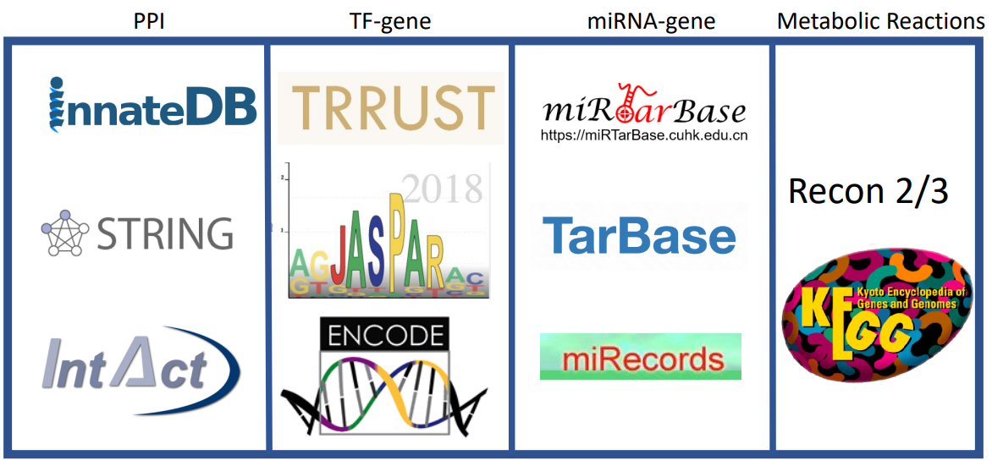
Databases

Slide 34
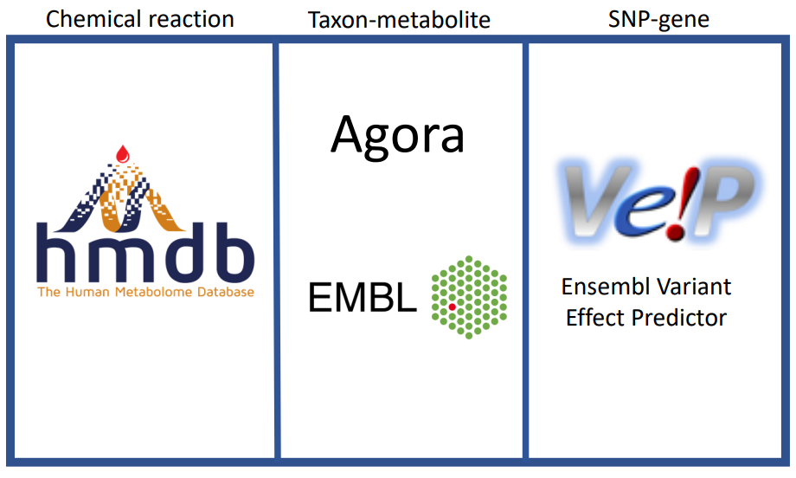

Slide 35
Use cases
Protein interaction analysis: crucial for studying biological processes such metabolic reactions.
Metabolic pathway analysis: helps identify conditions that may lead to metabolic disorders or cancer.
Gene expression analysis: It can assist in identifying biomarkers that can be used for disease diagnosis or predicting treatment response.
Multi-omics data analysis: This allows for a more holistic view of biological processes and their interrelationships.
It can aid in identifying new protein-protein or gene-gene interactions that may lead to the discovery of novel biological mechanisms.

Slide 36
Summary
Notes:
OmicsNet 2.0 is a network-based multi-omics analysis platform supporting both 2D and 3D network visual exploration. It enables support for three unordinary omics data inputs (SNPs, microbial taxa, and LC-MS peaks). It can reveal meaningful patterns, connections and functions. OmicsNet 2.0 addresses the need for easy-to-use web-based tools to support analysis of experimentally derived multi-omics data in their wider molecular context defined by our prior knowledge.

